Slide 1
Design Patterns
Factory Pattern

Slide 2
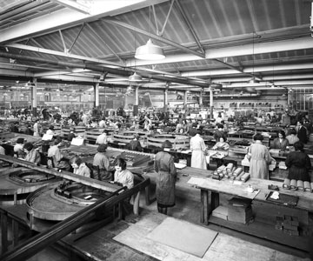
Factory Pattern
This is a factory
Meccano factory in Liverpool

Slide 3
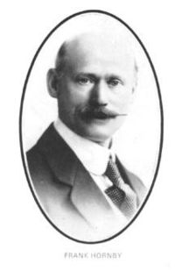
Nothing to do with the Lecture
Frank Hornby invented Meccano ...
... and of course Hornby Railways
He was born just outside Liverpool in a town called Maghull ...
... and so was I.

Slide 4
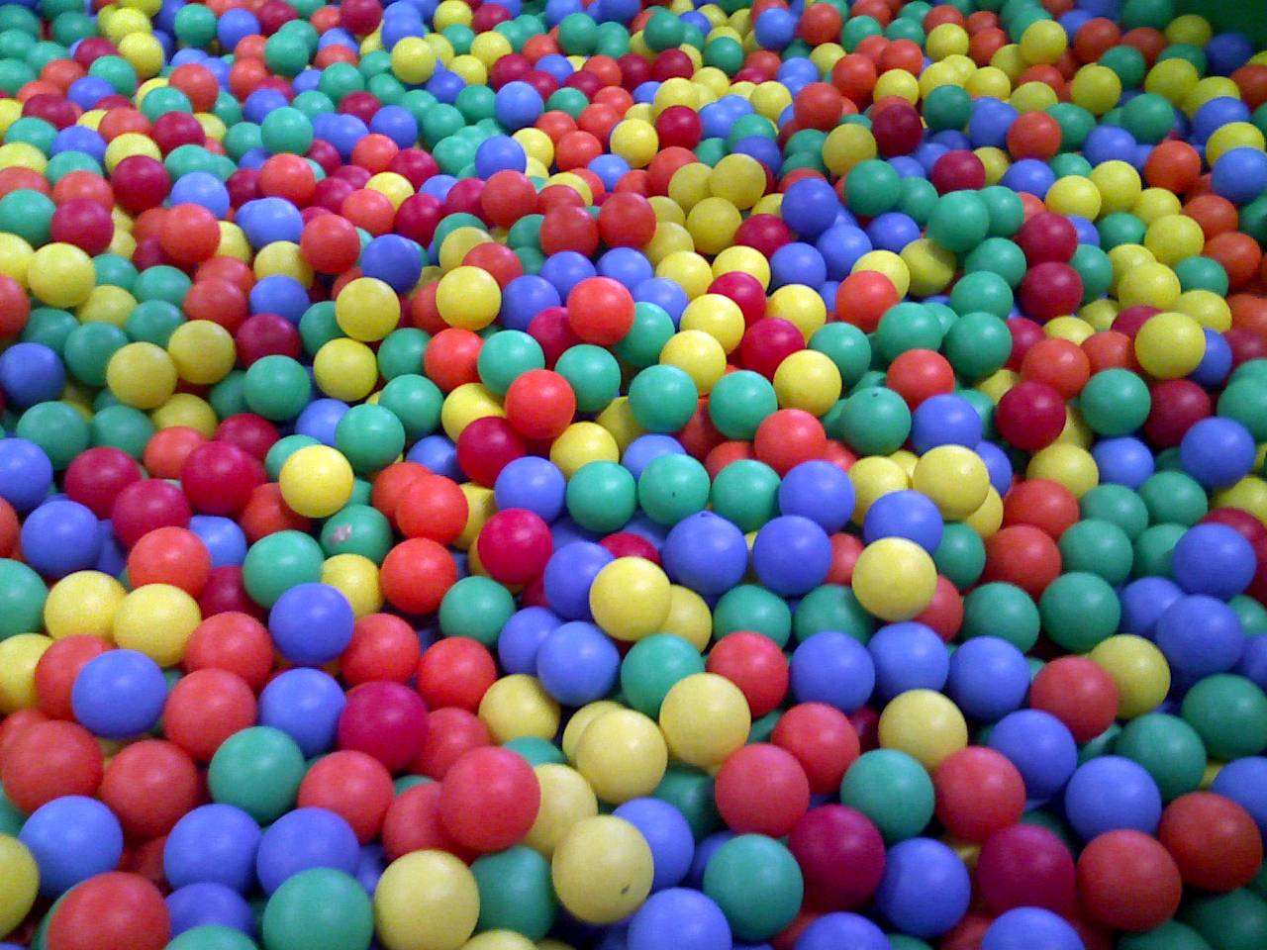
Game
Let’s create a game...
...called Coloured Balls

Slide 5

Game
This game might not last as long as Meccano
You ask for a coloured ball ...
... and then ask which colour has won the game ...
... it is always the colour of the ball that you have just received!
Who needs an XBOX?

Slide 6
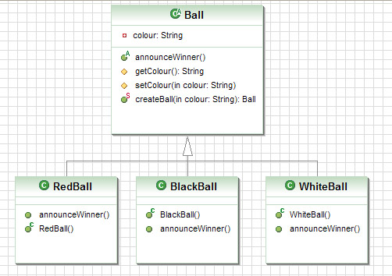
Game
You might start like this

Slide 7
Game
You can then play the game like this
public void playGame(String colour) {
  Ball ball;
ball = Ball.createBall(colour)
ball.announceWinner();
}

Slide 8
Game
Your createBall method would look like this
public static Ball createBall(String colour) {
Ball ball = null;
if (colour.equalsIgnoreCase("white")) {
ball = new WhiteBall();
}
else if (colour.equalsIgnoreCase("black")) {
ball = new BlackBall();
}
else if(colour.equalsIgnoreCase("red")) {
ball = new RedBall();
}
return ball;
}

Slide 9
Design Principle
Classes should be open for extension but closed for modification

Slide 10

Solution
Build a factory to make coloured balls
Please consider the environment before printing this slide!

Slide 11
Factory Pattern
Demo Time

Slide 12
Patterns
That is the Factory Pattern

